Slide 1

Notes:
#

Slide 2


Software Development Track
Problem Statement Title: AI-Powered Size Chart Generator for Apparel Sellers.
Date of Submission: 24th August 2024
Team Name | Dhuwaliaofficial
Team ID | UA8S3Y54
Institute Name/Names | Jaypee Institute of Information Technology (JIIT), Noida
Team Members | 1 | 2
Name | Anmol Dhuwalia | Harsh Kumawat
Batch (Passing Year) | 2026 | 2026
GITHUB REPOSITORY: https://github.com/harshk04/Flipkart-Grid-6.0/blob/main/Size%20Chart%20Generator.ipynb

Slide 3

AI-Driven User Size Prediction and Gender Specific Size Chart Generator for Apparel Sellers
Problem & Proposed Solution:
Apparel sellers struggle with generating accurate size charts due to limited or inaccurate data, leading to high return rates and customer dissatisfaction.
Model Utilization
Uses user body measurements and purchase/return history
Generates accurate size charts and predicts best fit (S, M, L, XL)
Clustering
Identifies and groups similar body types
Matches with successful purchase patterns
Size Chart Generation
Creates detailed size charts for Male and Female (S, M, L, XL, etc.)
Confidence Scores & Data Updating
Provides confidence scores for each measurement
Updates with new purchase and return data

Slide 4
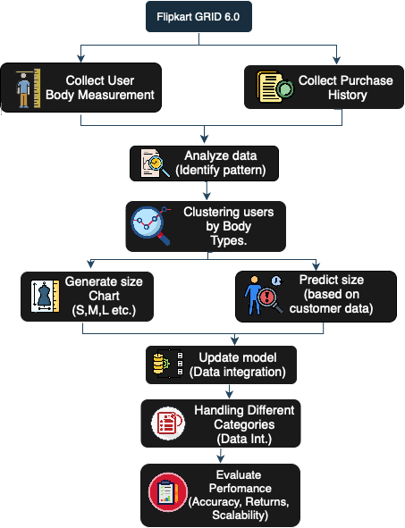
Objectives and Approach:
Generate accurate size charts to reduce returns and enhance customer satisfaction by analysing user measurements and purchase history.
Utilize machine learning for clustering and predictive modelling, with continuous updates for scalability across apparel categories.
Impact
Reduction in Returns
Enhanced Customer Satisfaction
Increased Sales
Streamlined Shopping Experience
Operational Efficiency
Fig.1: Flow Chart

Slide 5

METHODOLOGY
Data Preprocessing & Analysis
Data Pre-processing: Convert height/weight, handle missing values, and encode categories.
Analysis: Machine learning models identify patterns, cluster similar body types, and map to sizes.
Size Chart Generation
Generate Size Charts: AI creates and updates size charts with confidence scores (S, M, L, XL) for Men and Women.
TOOLS AND TECHNOLOGIES
Languages: Python
ML Libraries: TensorFlow, Keras, Scikit-Learn
Visualization: Matplotlib, Seaborn.
ALGORITHM
Clustering: K-means for body type grouping.
Classification: Random Forest, Gradient Boosting for size prediction.
Confidence Scoring: Derived from model probabilities to assess size recommendation reliability.

Slide 6
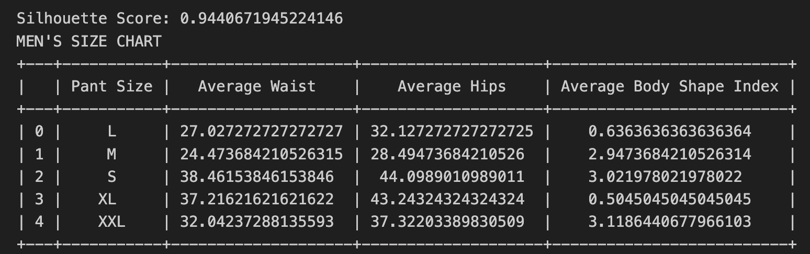
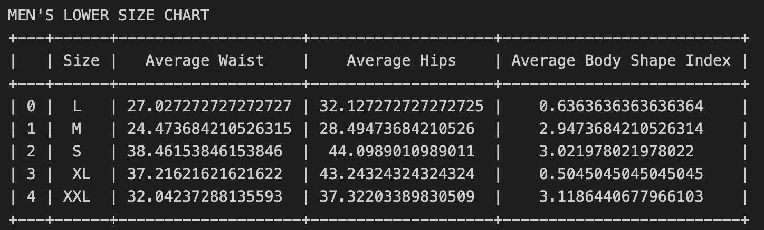
RESULTS & ANALYSIS
Men's Size Chart
Sizes
Size L: Average waist is 27.03, hips 32.13.
Size M: Waist increases to 24.47, with hips at 24.95.
Size XXL: Largest measurements with a waist of 32.04 and hips of 37.32.
Body Shape Index:
Size L: 0.64, indicating a slimmer build.
Size XXL: 3.12, showing a significantly broader body shape.
Fig.2: Men's Generated Size Chart
Fig.3: Size Chart Generated for Different Apparel
Silhouette Scores
Men’s Chart: Higher accuracy with a silhouette score of 0.94, reflecting better-defined clusters.

Slide 7
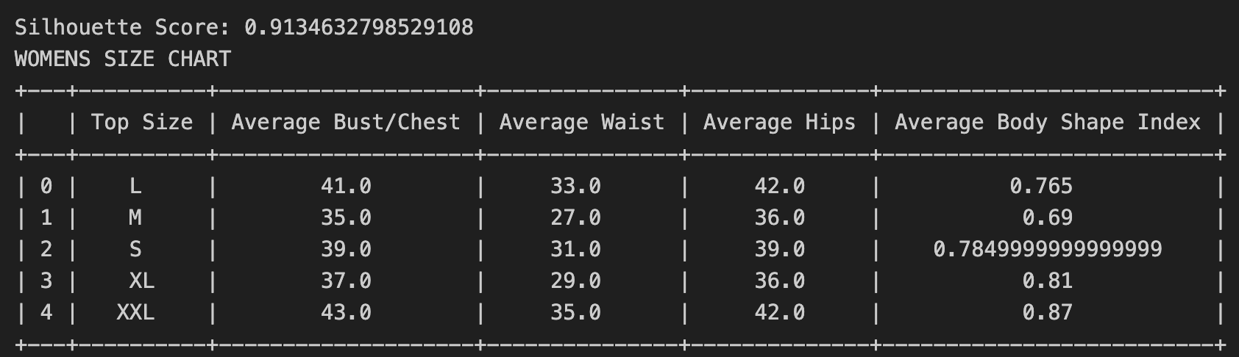
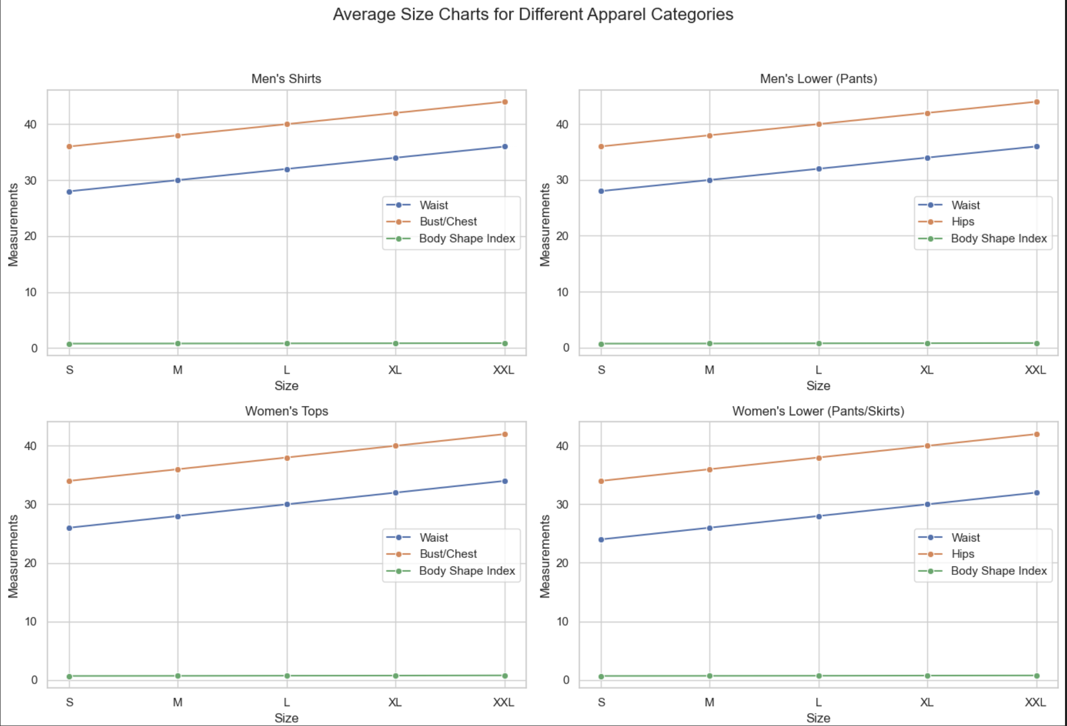
RESULTS & ANALYSIS
Women's Size Chart
Sizes:
Size M: Average bust/chest is 41.0, waist 33.0, hips 42.0.
Size L: Average bust/chest is 39.0, waist 31.0, hips 36.0.
Size XL: Largest size with an average bust/chest of 43.0, waist 35.0, and hips 42.0.
Body Shape Index: Ranges from 0.69 (M) to 0.87 (XXL), indicating the variation in body shapes across different sizes.
Silhouette Scores
Women’s Chart: 0.91, showing strong clustering and model accuracy
Fig.4: Women’s Generated Size Chart
Fig.5: Average Size Charts for Different Apparel Categories

Slide 8

CHALLENGES FACED
Data Quality: We introduced guided tools to reduce self-measurement errors, ensuring more consistent user data collection.
Handling Diverse Body Types: Trained the AI model with a diverse dataset of body types and added regional sizing adjustments to improve adaptability.
Integration with Existing Systems: We developed flexible API integration modules and used robust encryption to secure user data, ensuring regulatory compliance.
LIMITATIONS
Scalability and Performance: Managing large datasets and fast processing as user numbers grow can challenge system performance.
Adaptability and Compliance: Adapting to different brands and regional data privacy regulations may need ongoing adjustments.

Slide 9
RECOMMENDATIONS AND FUTURE WORK
Enhance Data Collection and Model Accuracy:
Implement standardized measurement guidelines and encourage user input verification.
Expand data sources by integrating customer feedback and collaborating with diverse brands.
Explore Broader Applications and Adaptability:
Apply the technology to footwear and accessories and investigate international sizing standards.
Continuously train the AI model with new data and trends to adapt to changing fashion styles.
Strengthen Data Privacy and User Trust:
Adhere to data protection regulations (e.g., GDPR) and implement strong encryption.
Design an intuitive interface, build trust with transparent AI processes, and address biases in the AI model.
Improve AI Integration and Scalability:
Develop robust APIs for seamless e-commerce integration and ensure compatibility with various data structures.
Invest in scalable infrastructure to handle growing datasets and ensure system performance during peak traffic.

Slide 10

APPENDICES
Detailed Data:
Comprehensive dataset of user body measurements, purchase history, and return/exchange data.
Additional Charts:
Visualizations of size recommendation accuracy and return rate improvements.
Charts comparing initial and post-implementation performance metrics.
Extended Explanations:
Technical documentation of AI algorithms and model training processes.
Case Studies:
Examples of successful implementation and impact on return rates and customer satisfaction.

Slide 11
Thank You !

